Slide 1




Recognized Leader in Geriatric Surgery
A new collaboration between The Leapfrog Group and the American College of Surgeons (ACS)
August 13, 2026

Slide 2

Webinar Reminders
Accessing the Audio
  If you are using computer audio, please select that option in the audio options pop up.
  If you are joining by phone, please dial in using the Toll Free 800 number provided. Then enter the Meeting ID when prompted, then your Participant ID.
    The Meeting ID can be found in the confirmation email or in the Zoom meeting by clicking the audio button in the bottom left-hand corner.
    The Participant ID can be found in the audio options in the bottom left-hand corner.
    If you forgot to enter the Participant ID when dialing in, please dial # then your Participant ID again followed by #.
Use of the Zoom Chat Function
  The Town Hall Call includes a live Q&A during the presentation; therefore, we do not monitor the chat for questions. Please reserve the Zoom Chat Function for reporting technical issues only.
Accessing the Slides & Recording
  Following each session, a copy of the slides and recording will be posted and available for download on the Leapfrog website here: https://www.leapfroggroup.org/recognized-leader-geriatric-surgery

Slide 3


Q&A
Participants will be able to ask questions during the presentation. Please select the Q&A icon at the bottom of your screen:
  Once the icon has been selected a Q&A box will appear for you to type your questions.
  All participants will be able to view the questions and answers during the duration of the webinar.
    You will be receiving responses in real time from a member of our team.
    We will include a transcript of the Q&A on the Leapfrog website here: https://www.leapfroggroup.org/survey-materials/town-hall-calls
    Some questions may be answered live – please pay close attention.
Following the presentation we will have a live Q&A session. Please use the Raise Hand icon at the bottom of your screen:
  Once the icon has been selected you will be placed in the queue. When it is your turn to ask your question, you will receive a prompt from the host asking you to unmute yourself.

Slide 4
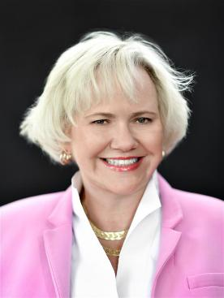


Today’s Speakers
Leah Binder, MA, MGA
President and CEO,
The Leapfrog Group
Clifford Ko, MD, MS, MSHS, FACS, FASCRS
Senior Vice President, Division of Research and Optimal Patient Care,
American College of Surgeons
Missy Danforth
Senior Vice President of Health Care Ratings,
The Leapfrog Group

Slide 5

Today’s Conversation & Key Questions
Why is improving surgical care for older adults important to Leapfrog and ACS?
Leapfrog Recognized Leader Program Overview
How do you get started?
  Eligibility
  Timeline
  Key requirements for recognition
  Application process
Introduction to ACS
GSV Application Process

Slide 6
Surgical Care for Older Adults: A Patient Safety Priority
  The population in the United States is expanding and aging
  In 2024, 61.2 million people (18%) were age 65 or older
  By 2030, that number is projected to reach 72.1 million
Major surgery is common among older Americans
  Adults aged 65+ account for 40% of all inpatient surgeries in the US
  There is a 3x higher risk of serious complications after surgery
Older adults have worse outcomes
  1 in 4 older surgical patients experience functional decline
  There is a 2.3x higher in-hospital mortality compared to younger adults
  A patient’s frailty—how strong, resilient, and independent they are—plays a big role in surgical risks, sometimes even more than age alone:
  Strong and not frail: About 1 in 5 patients (about 20%) had complications after major surgery.
  Somewhat frail: About 1 in 3 patients (about 34%) had complications.
  Frail: Nearly 1 in 2 patients (about 44%) had complications.
When hospitals improve surgery in this population, they’ll improve surgery for all populations
Many employers have retirees they are responsible for, so this is an extremely high priority for them as well
Leapfrog is committed to helping patients and family caregivers identify hospitals that offer safe, highest quality care. Providing national recognition to hospitals that have implemented robust surgical programs focused on the particular risks of older adults, and that have met Leapfrog’s national standards for patient safety and quality, is an important first step.

Slide 7

Leapfrog's Recognized Leader Programs
Measure performance, recognize excellence, and address evolving areas of high-risk patient care, particularly in hospital settings.
Recognize hospitals leading the way in specialized care – inpatients with diabetes, and surgical care for older adults.
These distinctions help patients, caregivers, employers and purchasers identify hospitals that have demonstrated excellence in specialized areas of care through evidence-based standards and transparent performance.

Slide 8
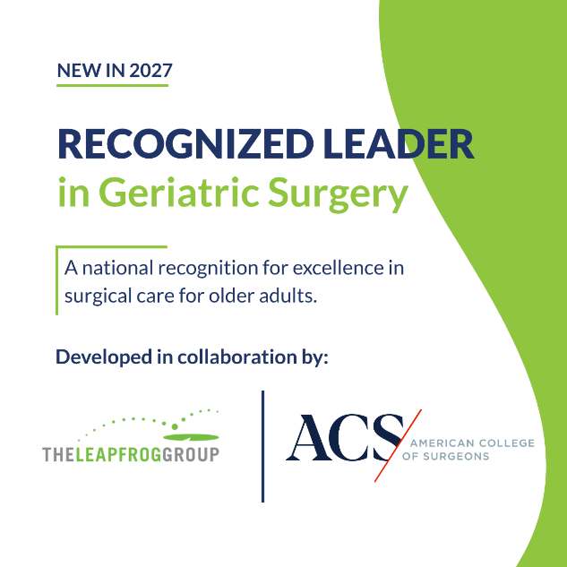
Leapfrog and ACS Partnership to Recognize Leaders in Geriatric Surgery
A new program to recognize hospitals that demonstrate excellence in providing safe, high-quality, patient-centered surgical care for older adults. To qualify:
  Participate in the ACS Geriatric Surgery Verification (GSV) Program
  Achieve Leapfrog’s patient safety standards, which we’ll be evaluating through the Leapfrog Hospital Safety Grade and Leapfrog Hospital Survey

Slide 9



Eligibility, Requirements, and Participation
Missy Danforth
Senior Vice President of Health Care Ratings,
The Leapfrog Group

Slide 10



How to Qualify for the Recognition
Apply to ACS Geriatric Verification Program
Submit a Leapfrog Hospital Survey by November 30
www.leapfroggroup.org/recognized-leader-geriatric-surgery

Slide 11
Achieving the Recognition
Meet ACS Geriatric Surgery Verification Program Standards
1
Achieve an A or B Leapfrog Hospital Safety Grade
2
Achieve or make considerable progress towards achieving the following standards from the Leapfrog Hospital Survey:
    Computerized Prescriber Order Entry (CPOE)
    Bar Code Medication Administration (BCMA)
    Medication Reconciliation
    Safe Surgery Checklist for Adult and Pediatric Complex Surgery
3

Slide 12
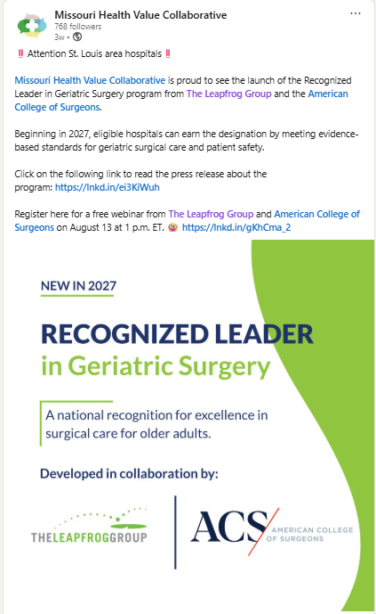

Purchasers, Employers, and Payors Use Leapfrog Ratings and Recognition Programs
Leapfrog’s constituents and partners use our public ratings and recognition programs to inform value-based strategies and payment programs:
  Capital Blue Cross uses Survey Results through Leapfrog’s VBP Program to support contracting and performance discussions.
  TRICARE's servicing health plans use the Hospital Survey Results to assess network facilities serving active-duty military members and their families, including incentive programs tied to Survey performance.
  Blue Cross and Blue Shield of North Carolina uses select Leapfrog Hospital Survey Results in its contracting strategy.
  Leapfrog’s Regional Leaders promote Recognized Leaders locally as well
Notes:
We work with many constituents and partners who utilize the public ratings and recognition programs, including; READ BULLETS

Slide 13





Hospitals and Health Systems Use Leapfrog Ratings and Recognition Programs
Participating hospitals and health systems use Leapfrog’s public reporting website and recognitions to build program awareness and increase market share -

Slide 14
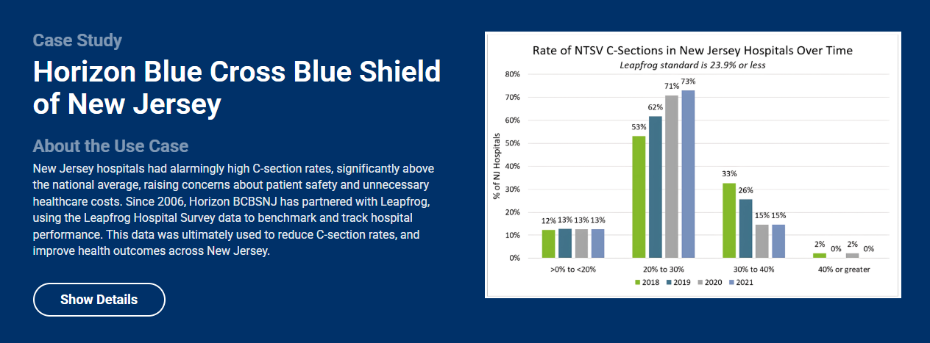
Use of Leapfrog Hospital Survey Results – Horizon BCBS of New Jersey Case Study
Horizon Blue Cross Blue Shield of New Jersey Case Study | Leapfrog
Notes:
Horizon Blue Cross Blue Shield of New Jersey used Survey data in contracting previously and is actively using the VBP program.
Horizon Blue Cross Blue Shield of New Jersey Case Study | Leapfrog

Slide 15

Looking Forward
First year: only focused on hospitals
Opportunity: expand recognition to include ambulatory surgery centers (ASCs)

Slide 16
Recognized Leaders Timeline
November 30, 2026: Deadline to submit a Leapfrog Hospital Survey
Fall 2026: Apply to GSV program and Site Visit Preparation
  Complete online application (< 5 minutes to complete)
  Complete Pre-Review Questionnaire (PRQ) to evaluate compliance with standards and schedule site visit (1-3 months)
Jan/Feb 2027: On-site visit for GSV
  Virtual site visit – no chart review (3-hours)
February/March 2027: Site review
  Site visit findings are reviewed by GSV Program clinical peer reviewers and report is provided to hospital (6-8 weeks)
April 2027: GSV Recognition!
  GSV Verification and SQP partner (Verified for 3 years)
May/June 2027: First Recognitions Awarded!
  Hospitals can continue to apply to the GSV program to be eligible for recognition in 2028; Leapfrog Survey Submission is required every year.
Notes:
Badges will be displayed next to recognized hospitals on Leapfrog’s public reporting website: https://ratings.leapfroggroup.org/.
Hospitals that do not meet the criteria will not be identified.
Hospitals that do not achieve the recognition will not be identified and invited to reapply for 2028 recognition

Slide 17
Haven’t Submitted a Leapfrog Hospital Survey Yet?
Visit www.leapfroggroup.org/hospital or contact the Help Desk to schedule a 1:1 Orientation Call.
Upcoming Survey Deadlines:
November 30: Late Submission and Performance Update Deadline
  The 2026 Leapfrog Hospital Survey will close to new submissions and re-submissions that reflect updates to performance at midnight ET on November 30. No new Surveys, new Survey sections, or performance updates to previously submitted sections of the Survey can be submitted after this deadline. In addition, the CPOE Evaluation Tool will go offline at 11:59 pm ET on November 30.
  Only hospitals that have submitted a Survey by November 30 will be able to log in to the Online Survey Tool to correct data entry or reporting errors (i.e., in response to Leapfrog’s Extensive Monthly Data Verification) to previously submitted sections during the months of December and January. Updates made to reflect a change in performance after November 30 will not be scored or publicly reported. New sections of the Survey submitted after November 30 will not be scored or publicly reported.
  Adult and general hospitals that would like Leapfrog Hospital Survey Results included in the spring 2027 Leapfrog Hospital Safety Grade must submit a Survey by November 30 in order to have Survey Results available for the January 31 Data Snapshot Date.
January 31: Corrections Deadline
  Hospitals that need to correct data entry or reporting errors (i.e., in response to Leapfrog’s Extensive Monthly Data Verification) to previously submitted sections of the 2026 Leapfrog Hospital Survey must make necessary corrections and re-submit the entire Survey by January 31, 2027. Hospitals will not be able to make changes or re-submit their Survey after this date.
  This is the date that Leapfrog will obtain the public data (i.e., download data published by CMS or submitted via the Leapfrog Hospital Survey) to calculate the spring 2027 Hospital Safety Grades. All data, including Survey Results, must be finalized by this date.
Notes:
Hospitals that do not meet the criteria will not be identified.

Slide 18
Introduction to American College of Surgeons and the GSV Program
Clifford Ko, MD, MS, MSHS, FACS, FASCRS
Senior Vice President, Division of Research and Optimal Patient Care,
American College of Surgeons

Slide 19
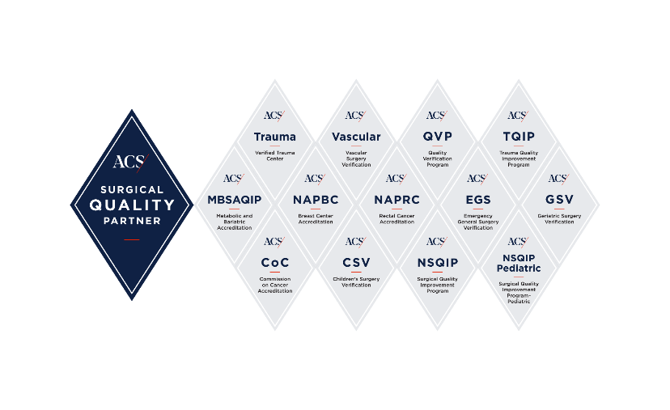


American College of Surgeon's Commitment to Quality
110+ years
COMMITTEE ON TRAUMA & COMMISSION ON CANCER FOUNDED
FOUNDED
1917
1951
1913
MINIMUM
HOSPITAL
STANDARDS WRITTEN
1922
JOINT
COMMISSION
FOUNDED*
13 accreditation and verification programs
to improve surgical care & provide better outcomes for all patients.
© American College of Surgeons. Content cannot be reproduced or repurposed without written permission of the American College of Surgeons.
Notes:
*Our early quality work led to the founding of the Joint Commission in 1951, and it has remained a global driver of quality improvement and patient safety in health care for more than 70 years. ​

Slide 20

Geriatric Surgery Verification (GSV)
Complex physiological and social issues challenge our health-care system's current perioperative care model.
The ACS developed the Geriatric Surgery Verification (GSV) Program to address this.
It includes evidence-based standards that specifically address and optimize the surgical care of patients.
© American College of Surgeons. Content cannot be reproduced or repurposed without written permission of the American College of Surgeons.
Notes:
As the fastest-growing segment of the U.S. population, older adults bring a complexity in physiological and social issues that challenge our current health-care system's perioperative care model. To address this challenge, the ACS developed the Geriatric Surgery Verification (GSV) Program.
The program includes evidence-based standards that specifically address and optimize the surgical care of patients.

Slide 21
GSV Program Goals
Systematically improve surgical care and outcomes for older adults by promoting patient- and family-centered care including patient goal identification and attainment.
1
2
Encourage interdisciplinary input and collaboration and facilitate implementation of evidence-based practices.
Concisely address the most important aspects of geriatric surgical care within the four-part ACS quality improvement framework (i.e., standards, infrastructure, data, verification)
3
© American College of Surgeons. Content cannot be reproduced or repurposed without written permission of the American College of Surgeons.
Notes:
As the fastest-growing segment of the U.S. population, older adults bring a complexity in physiological and social issues that challenge our current health-care system's perioperative care model. To address this challenge, the ACS developed the Geriatric Surgery Verification (GSV) Program.
The program includes evidence-based standards that specifically address and optimize the surgical care of patients.

Slide 22
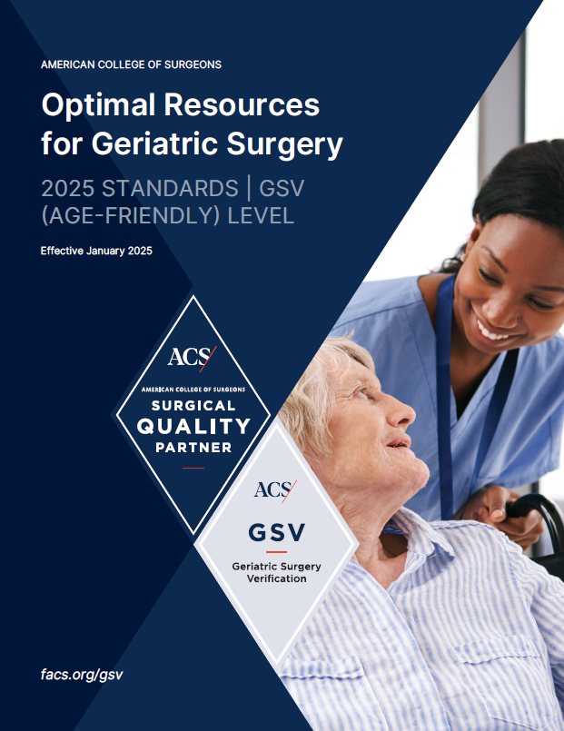
GSV (Age-Friendly) Level
6 Standards – no chart review
Applicable to patients 65+ undergoing inpatient surgery
​
1
Age-Friendly Care Leadership​
4
Management Plan for Patients with Positive Screens​
2
Treatment & Overall Health Goals
5
Age-Friendly Postoperative Protocol ​
3
Geriatric Vulnerability
Screens
6
Data Review
Age-Friendly Care Leadership​
Download the Standards on the GSV Website: www.facs.org/geriatrics
© American College of Surgeons. Content cannot be reproduced or repurposed without written permission of the American College of Surgeons.
Notes:
Aligns with the new Age Friendly Hospital Measure
Hospitals found compliant in all 6 Standards are awarded verification status
*The majority of hospitals will be able to achieve this level with minimal resources required.

Slide 23

How Do Hospitals Qualify for the GSV Program?
Surgical Scope:
  Begin in one or a few surgical specialties
  Rollout in whole hospital
Applicable to:
  Community Hospitals
  Teaching and Non-teaching Hospitals
  Academic Hospitals
  Government Hospitals
  Rural Hospitals
Patients:
  65 years and older
  Inpatient procedures
© American College of Surgeons. Content cannot be reproduced or repurposed without written permission of the American College of Surgeons.

Slide 24
The Case for GSV: Better Outcomes, Lower Costs
Hospitals implementing the GSV Program report significant improvements across key outcomes and fewer complications
Clinical Impact | Financial/Operational Impact
Shorter Length of Stay | GSV implementation reduced average hospital length of stay by 2.1 days, from 6.5 to 4.4 days. Each avoided inpatient day may save approximately $650–$1,000 in variable cost.
Lower Postoperative Delirium | Delirium is estimated to cost $20K per admission. Preventing only 5 cases could represent >$100K in avoided costs.
Fewer Major Complications | Major complications can add roughly $10K–$50K, and in some cases substantially more, to the cost of hospitalization. Geriatric pathways have demonstrated reductions in major complications.
Earlier Delirium Risk Identification | GSV hospitals screened 94.3% vs. 52.5% at non-GSV hospitals. Among screened patients, GSV hospitals also had shorter LOS and fewer prolonged stays.
Lower Patient Mortality | The death rate after surgery was reduced by nearly half from 10.2% to 5.7% at one hospital after implementing the ACS GSV program standards.
Preserving Functional Independence | 72% lower odds of increased care needs at discharge, supporting preservation of independence after surgery.
A geriatric surgery pathway improved outcomes and lowered inpatient cost by $2,091 per patient
© American College of Surgeons. Content cannot be reproduced or repurposed without written permission of the American College of Surgeons.
Notes:
References:
Making a Financial Case for the Geriatric Surgery Verification Program: https://pmc.ncbi.nlm.nih.gov/articles/PMC11191881/
Geriatric Surgery Verification Program Can Improve Outcomes for Older Cancer Patients in Community Hospitals: https://www.facs.org/media-center/press-releases/2024/geriatric-surgery-verification-program-can-improve-outcomes-for-older-cancer-patients-in-community-hospitals
Geriatric Surgery Verification Hospitals Report Higher Delirium Screening Rates: https://www.facs.org/for-medical-professionals/news-publications/news-and-articles/acs-brief/june-16-2026-issue/geriatric-surgery-verification-hospitals-report-higher-delirium-screening-rates
ACS Program Cuts Surgical Deaths and Improves Care for Older Adults, Studies Show: https://www.facs.org/media-center/press-releases/2024/acs-program-cuts-surgical-deaths-and-improves-care-for-older-adults-studies-show
Horattas I, et al. Decreased Patient Mortality Following Implementation of Geriatric Surgery Verification Standards, Scientific Forum, American College of Surgeons (ACS) Clinical Congress 2024.
https://pmc.ncbi.nlm.nih.gov/articles/PMC10524651

Slide 25

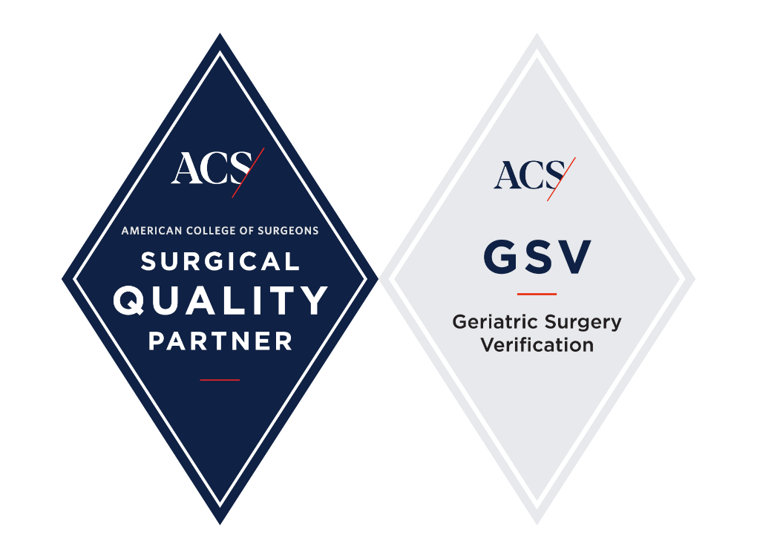

GSV Application Process
Notes:
Explain how hospitals qualify for ACS Geriatric Surgery Verification.
Review the key standards and application process.
Share how hospitals can begin preparing.

Slide 26
Overview of Verification Process
Complete online application
< 5 minutes to complete
Virtual site visit – no chart review
3-hours
GSV Verification and SQP partner
Verified for 3 years
Application & Preparation
Site Visit
Recognition
Complete Pre-Review Questionnaire (PRQ) to evaluate compliance with standards and schedule site visit
1-3 months
Site visit findings are reviewed by GSV Program clinical peer reviewers and report is provided to hospital
6-8 weeks
© American College of Surgeons. Content cannot be reproduced or repurposed without written permission of the American College of Surgeons.

Slide 27
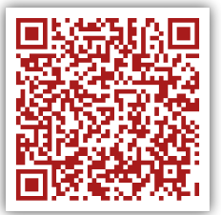
Take Action Now, Enroll Today! ​
Apply now so your hospital can become a Recognized Leader in Geriatric Surgery by Spring 2027!
    Apply on the GSV Website by October 2026
    Site visit in January or February 2027
The GSV Team is here to help every step of the way!
Book a call now to learn more about the GSV Program and how to facilitate this at your hospital:
© American College of Surgeons. Content cannot be reproduced or repurposed without written permission of the American College of Surgeons.

Slide 28
Hospital Benefits of GSV
High-quality clinical data
Benchmark performance, identify gaps, and drive quality improvement
Expert-developed standards
Evidence-based standards to guide best practices in older adult surgical care
ACS Quality Programs provide hospitals with the infrastructure and resources necessary to deliver high-quality, patient-centered care, optimize performance, improve outcomes, and maximize existing resources.
Efficient resource allocation
Target resources to patients at highest risk for the greatest impact
Multidisciplinary collaboration
Strengthen collaboration across surgical specialties
Cost Savings
Fewer complications and readmissions can save hospitals money
Reduced variability in care
Standardized care pathways to deliver consistent care
Improved Outcomes
Reduce preventable complications including postop delirium and falls
Recognition and Verification
Earn GSV verification and become a leader in older adult surgical care
© American College of Surgeons. Content cannot be reproduced or repurposed without written permission of the American College of Surgeons.

Slide 29

The question is no longer whether we operate on older adults.
The question is how we optimize them before surgery, care for them during hospitalization, and preserve what matters most after surgery.
This partnered program of Leapfrog and the ACS is recognizing the hospitals that are committed to this mission.
© American College of Surgeons. Content cannot be reproduced or repurposed without written permission of the American College of Surgeons.

Slide 30
Recognized Leaders Timeline
November 30, 2026: Deadline to submit a Leapfrog Hospital Survey
Fall 2026: Apply to GSV program and Site Visit Preparation
  Complete online application (< 5 minutes to complete)
  Complete Pre-Review Questionnaire (PRQ) to evaluate compliance with standards and schedule site visit (1-3 months)
Jan/Feb 2027: On-site visit for GSV
  Virtual site visit – no chart review (3-hours)
February/March 2027: Site review
  Site visit findings are reviewed by GSV Program clinical peer reviewers and report is provided to hospital (6-8 weeks)
April 2027: GSV Recognition!
  GSV Verification and SQP partner (Verified for 3 years)
May/June 2027: First Recognitions Awarded!
  Hospitals can continue to apply to the GSV program to be eligible for recognition in 2028; Leapfrog Survey Submission is required every year.
Notes:
Badges will be displayed next to recognized hospitals on Leapfrog’s public reporting website: https://ratings.leapfroggroup.org/.
Hospitals that do not meet the criteria will not be identified.
Hospitals that do not achieve the recognition will not be identified and invited to reapply for 2028 recognition

Slide 31




Thank you!
Visit the Recognized Leader in Geriatric Surgery webpage for more information and application information.
Follow The Leapfrog Group and the American College of Surgeons on all social channels for program updates and application announcements.
leapfroggroup.org/recognized-leader-geriatric-surgery

Slide 32
Q&A
Participants will be able to ask questions during the presentation. Please select the Q&A icon at the bottom of your screen:
  Once the icon has been selected a Q&A box will appear for you to type your questions.
  All participants will be able to view the questions and answers during the duration of the webinar.
    You will be receiving responses in real time from a member of our team.
    We will include a transcript of the Q&A on the Leapfrog website here: https://www.leapfroggroup.org/survey-materials/town-hall-calls
    Some questions may be answered live – please pay close attention.
Following the presentation we will have a live Q&A session. Please use the Raise Hand icon at the bottom of your screen:
  Once the icon has been selected you will be placed in the queue. When it is your turn to ask your question, you will receive a prompt from the host asking you to unmute yourself.

