Slide 1

Section 2. Introduction to Patient & Family Engagement
Part One: What is it, how does it work, and why is it so important?
Notes:
o Our first section of material is about Patient and Family Engagement. There are two decks in this section, and we will start with some background information.

Slide 2

What is Patient and Family Engagement?
Notes:
o Over the next several slides, we will be talking and learning about “Patient and Family Engagement” or PFE for short. While some of you may be very familiar with this phrase and this concept, for others of you it may be new. This will be an interactive session and you will have plenty of opportunities to ask questions and provide your perspectives as we explore the material.

Slide 3
Have you heard the phrase “Patient and Family Engagement”? ​
What does the phrase mean to you? ​
Have you been involved in Patient and Family Engagement activities?​
Notes:
o This will be an open discussion with the group; you should pose each of the questions on the slide and capture remarks from the group on an editable slide, chalkboard/whiteboard/flipchart. Please note: this information will be used for an activity in Slide 9.
o Maybe by a show of hands or other acknowledgment, how many of you have heard the phrase patient and family engagement?
o Acknowledge the nods/shakes/other responses and remark accordingly—for example, “it looks like everyone is at least somewhat familiar” or “it looks like there’s a bit of variation.”
o And now let’s explore—what does that phrase mean to you?
o You capture what is shared—you don’t need to capture everything verbatim, high-level summaries are fine. Let this discussion go on for a few minutes until everyone who wanted to contribute has contributed, and then remark accordingly “lots of great ideas” or “thanks so much for sharing these.”
o And finally, have any of you been involved in patient and family engagement activities and if so, what were they?
o You capture what is shared in high level summaries. Let this discussion go on for a few minutes until everyone who wanted to contribute has contributed, and then remark accordingly “lots of good examples” or “thanks so much for sharing these.” Note: this information will be used for an activity in Slide 9.

Slide 4

Shared decision-making
Advocating for policy
Patient faculty members
teaching medical students​
Using patient-friendly language in hospital discharge instructions​
Educational materials for patients​
Examples of PFE outcomes
Easy-to-use online patient
medical record portals​
Pushing to pass laws to
improve access to healthcare​
Flexible hospital visiting hours​
Notes:
o Highlight examples of PFE activities and outcomes.
o As many of you have shared, there are so many ways that PFE happens! In addition to what was mentioned, I want to highlight the examples listed on the slide—such as shared decision-making between patients and providers, which ensures patients can express their desired goals and needs. Or patients advocating for policy change at the system level—which is so important for making sure policies address the things we as patients care most about. Additionally, patients serving as faculty members and helping to train clinicians is another example—which can help providers see patients as partners in their care, instead of only passive recipients of care.
o Patients can’t be “engaged” in their own care if the discharge instructions they get from the hospital aren’t clear and easy to understand. Educational materials for patients are also very important as are easily accessible online medical record portals that give us access to important information about our health. Patients can also be advocates who work to pass laws on all kinds of issues related to their care. Even creating flexible hospital visiting hours has an effect on patients and their families and can be an important way to support engagement.

Slide 5



PFE is defined as;
“ Patients, families, their representatives, and health professionals working in active partnership at various levels across the health care system – direct care, organizational design and governance, and policymaking, to improve health and healthcare.”
Shared
Decision-Making
Policy Change
Advocacy
Educational Empowerment
Carman KL, et al. Patient and family engagement: a framework for understanding the elements and developing interventions
and policies. Health Aff (Millwood). 2013 Feb;32(2):223-31. doi: 10.1377/hlthaff.2012.1133. PMID: 23381514.
Notes:
o One common definition of patient and family engagement is provided here on this slide. “Patients, families, their representatives, and health professionals working in active partnership at various levels across the healthcare system – direct care, organization design and governance, and policymaking, to improve health and healthcare.”
o But as you’ve seen, there are so many activities and ideas that fall under the umbrella of “patient and family engagement”, and the phrase means different things to different people, and it can cause confusion.

Slide 6


TWO TYPES OF ENGAGEMENT
Type A
Personal Engagement
Type B
Health System Engagement
Patients and families actively involved in efforts at the system or organizational level to improve diagnosis and care​, and overall healthcare experience.
Patients and families actively involved in their own care, diagnosis, disease management, and treatment.
Notes:
o One way to help to avoid that confusion is to divide the many patient engagement activities into two main types. The first type, “Type A” or “personal engagement”, describes patients and families who are actively involved in their own diagnosis and care. The second type, “Type B” or “system level engagement”, is patients and families who are actively involved in efforts at the system or organizational level. We’ll look at each type in a little more detail.

Slide 7
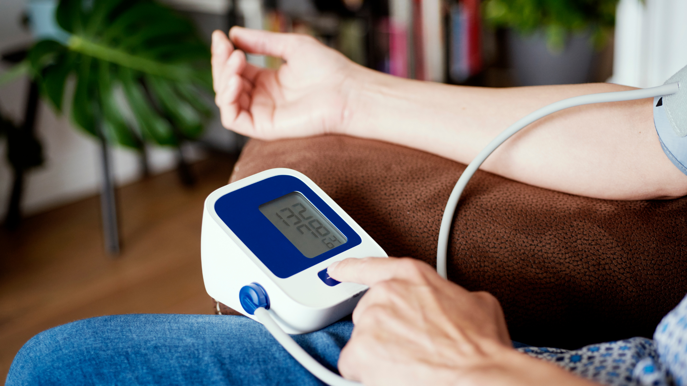
Examples of
Personal Engagement?
(Type A)
Active patient/family involvement in their own care and diagnosis
Shared decision making with providers
Education about one’s own conditions and how to manage their care
Notes:
o Personal engagement (type A) would include activities like being active in your own care—taking notes, asking questions, accessing and using information in your patient portal, feeling like you can have shared decision-making with your provider, and becoming informed and educated about your health and any conditions you may have, but many other things fall under this type A engagement.

Slide 8

Examples of
Health System Engagement?
(Type B)
Serving on a Patient and Family Advisory Council
Partnering on a research team to improve care at a hospital
Patient faculty teaching health professions students
Notes:
o System level engagement (Type B) would include things like serving on a PFAC—again, like all of you! This could also mean partnering on a research team at the hospital—so not being involved in research as a “participant” or “subject”, but sitting side by side with researchers and clinicians to design and conduct research. Another example is patients being involved as patient or family faculty at the hospital—helping to teach or evaluate clinicians or students.
o There is not a type of patient engagement that is better than the other—both are very important and each one feeds into the other. For example, in order for a hospital to develop effective strategies and programs to support patient and family engagement in their own diagnosis and care—Type A or personal—they should partner with PFACs or other patient and family members to develop those strategies—Type B or system level.
o One of the reasons it is helpful and important to distinguish between the two types of patient engagement, is that MOST people are really referring to Type A engagement when they say “patient and family engagement”. That can create barriers for patients and families who want to engage in Type B engagement activities. Throughout the sections of this toolkit, we’ll use this Type A and Type B distinction so that we can avoid any confusion about what we’re talking about.
o Let’s pause here for questions—does this make sense? Any questions about this distinction? There are certainly activities that may fall somewhere in the middle, so this is not a perfect “division”, but it is often very helpful.
o Pause for questions and comments for 2-3 minutes, and then when conversation has ended or when 2-3 minutes have passed, indicate that you are going to move on

Slide 9
Shared decision-making
Advocating for policy
Patient faculty members
teaching medical students​
Using patient-friendly language in hospital discharge instructions​
Educational materials for patients​
Examples of PFE outcomes
Easy-to-use online patient
medical record portals​
Pushing to pass laws to
improve access to healthcare​
Flexible hospital visiting hours​
Notes:
o Now that we have talked through the division between the two types of engagement, we can look back at this list of activities and those that you all shared earlier and start to see which ones are which type.
o Start with the list you compiled (either on the editable slide or the flip chart or whiteboard in the room) from what the PFAC contributed during slide 3 and ask the group to offer thoughts on whether each activity is A or B, and then do the same thing using the list on slide 9.
o For the items on the slide, encourage PFAC members to offer answers, but if needed, you can provide the following guidance—and remember that no answers are “wrong”, necessarily, but generally speaking:
o Shared decision-making is Type A or personal
o Advocating for policy—like at the federal or state level is Type B or system level
o Patient faculty teaching students is Type B or system level
o Using patient-friendly hospital discharge language is Type A or personal
o Educational materials for patients is Type A or personal
o Easy to use online portals is Type A or personal
o Pushing to pass laws to improve access to healthcare is Type B or system level

Slide 10
Why is Type A - Personal Engagement so important?
Notes:
o Lead a discussion using an editable slide, chalkboard/whiteboard/flipchart, asking the group to answer the following questions.
o Thinking first about Type A or personal engagement—so engagement of patients and families in their own diagnosis or care—can any of you share an example of when your engagement in your (or your loved one’s) own diagnosis or care was beneficial? Or how a lack of engagement—not having enough information, not having a good partnership with a healthcare provider—caused a poor outcome?
o Let the discussion go on for 5-6 minutes before moving to the next slide. Capture what is shared (in high level summaries) on either the editable slide you added, or the chalkboard/whiteboard/flipchart. *Note that anything particularly interesting or important may be something you want to circle back to later in the Section or in later Sections, or keep on the radar for a future project. If folks are shy to talk or there are not many volunteers to speak, move to the next slide sooner. When the conversation feels like it is winding down, indicate you’re moving to the next slide and thank them for contributing (i.e., “thank you for sharing those examples!”).

Slide 11

Being an empowered, knowledgeable partner in your healthcare—or as an advocate for your loved one’s care—has been shown to improve healthcare outcomes.
Notes:
o What we know from research and from years of evidence is that patients who are engaged in their own diagnosis and care have better health outcomes.

Slide 12
Why is Type B - System Level Engagement so important?
Notes:
o Lead a discussion using an editable slide, chalkboard/whiteboard/flipchart, asking the group to answer the following questions.
o Thinking now about Type B or system level engagement—so engagement of patients and families in efforts at the system or organizational level to change and improve healthcare—can any of you share an example of how this type of engagement was beneficial? Or how a lack of engagement—not having any patient or family partners to help build solutions—backfired?
o Let the discussion go on for 5-6 minutes before moving to the next slide. Capture what is shared (in high level summaries) on either the editable slide you added, or the chalkboard/whiteboard/flipchart. *Note that anything particularly interesting or important may be something you want to circle back to later in the Section or in later Sections, or keep on the radar for a future project. If folks are shy to talk or there are not many volunteers to speak, move to the next slide sooner. When the conversation feels like it is winding down, indicate you’re moving to the next slide and thank them for contributing (i.e., “thank you for sharing those examples!”).

Slide 13

Having patients and families partner with hospital administrators to help fix problems and develop new solutions is increasingly recognized as a best practice.
Notes:
O Even though this type of patient and family engagement –Type B or system level, has not become the norm across all of healthcare, we have made great strides over the past two decades and the evidence of the value of this type of engagement is growing at a rapid pace. We will look next at two examples of how Type B or system-level engagement has made a difference.

Slide 14

Example 1: Missing Key Information
Pregnancy-related emergency conditions can be missed
What could ensure patients report and clinicians make note of this information?
SIDM Patient Summit Conference Proceedings, Minneapolis, MN, October 2022.
Notes:
o Because this whole Toolkit is focused on diagnostic quality, we will look at two examples focused on improving diagnosis.
o First, in a project about improving the diagnosis of pregnancy-related conditions in the emergency department, the issue of awareness came up—that clinicians may not know or realize that a person recently had a baby, and a person who recently had a baby may not know they should report that information to the folks at the emergency department. Heart and other complications can arise even months after a pregnancy. Patient and parent advocates and clinicians talked about ways to address this problem. The patients suggested having signs in the waiting room or in the emergency room, encouraging them that it would be valuable to share news of a recent pregnancy with the medical team. They also shared that it would be important that the medical teams in the emergency department receive training to know that a recent pregnancy was very important information because of the risks of complications. Having that first-hand experience from patients was key to understanding what would be most helpful and likely to support them in a situation like this.

Slide 15

Example 2: Removing Barriers to Patients Attending Follow-Up Appointments
Missing follow up appointment can lead to diagnostic delays
Are reminders enough for follow-up with patients?
What are the real barriers?
Notes:
o This second example is really a combination of projects—and an example of what goes wrong when patients and families are not partners in efforts to try to improve diagnostic quality. There have been many projects to address the issue of patients not scheduling or not completing follow-up tests like x-rays or CT scans that were prescribed by their doctors. The projects almost always focus on increasing the number of reminders to patients, assuming the reason patients are not completing these tests is because they aren’t remembering to follow up.
o While some patients may just be “forgetting”, any of us with lived experiences with illness or injury know that there are a host of barriers that have nothing to do with “remembering” to schedule the follow-up test. For example, spending hours on the phone to try to schedule a follow up appointment or test, having to miss work or travel great distances to get to the place that has the test, not having transportation to get to the place that has the test, insurance companies denying authorization for the test—are just some of the many reasons! Wouldn’t it be great if patient partners were invited to help design solutions to this problem?
o Let’s pause for a minute and see if there are any questions over what we’ve covered—or any additional examples of either Type A or personal engagement or Type B or system level engagement that have come to mind for you.
o Pause and give the PFAC members a minute or two to ask clarifying questions or offer examples; if they share an example, be sure to capture it in an editable slide or on the flipchart/whiteboard/chalkboard in the room. When it is time to wrap up, indicate you are moving to the next slide and thank them for their contributions

Slide 16

Let’s review what we’ve discussed
Concept of “Patient and Family Engagement”
Your experiences with the concept
Type A and Type B engagement
Why engagement is so important?
Notes:
o Let’s take a minute to review everything we’ve just covered and shared. We started with looking at the phrase “Patient and Family Engagement” and how it means many different things to different people and covers a whole host of important activities. You all then shared your rich and important experiences with patient and family engagement. Next we learned about the Type A or personal and Type B or system level engagement distinction that we can use to help clarify which type of engagement we’re talking about in our work. And finally we ended by discussing why engagement is so very important. Is there anything else anyone wants to ask or say before we close?
o Pause and give the PFAC members a minute or two to ask clarifying questions. When it is time to wrap up, indicate that this section is concluding.

Slide 17
Thank You!
Notes:
o Thank you so much for your time and participation—this was a great and productive session!
o The next session in this section of material will focus more specifically on how Patient and Family Advisory Councils do Patient and Family Engagement.

