Slide 1
Section 3. Understanding the Diagnostic Process and Diagnostic Safety
Part One: Diagnosis and the Diagnostic Process
Notes:
o This is the first part of Section 3 Understanding the Diagnostic Process and Diagnostic Safety.

Slide 2
The Diagnostic Process
Notes:
o Start with a group discussion of the term “diagnosis” by asking the following question.
o Even though it is a single word, the word diagnosis actually represents a whole process. Thinking about your own medical care, what types of experiences have you had with getting a diagnosis?
o Pause for input, if none or slow, start to offer prompts (below) to invite conversation
o For example, the process of diagnosis could include testing the blood or urine or other fluids, or taking images with x-rays or CT scans, or even having exploratory surgery. Has anyone had experience with one or more of those things?

Slide 3
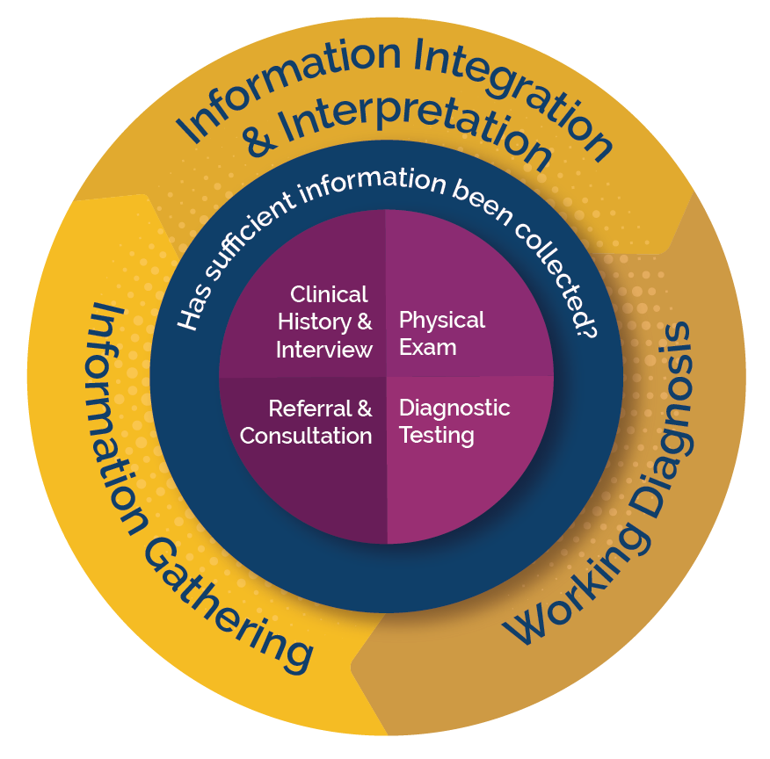
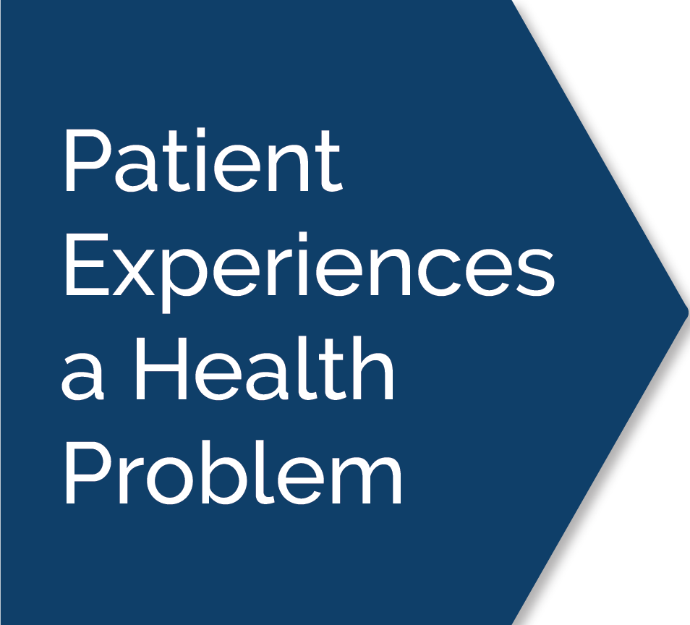
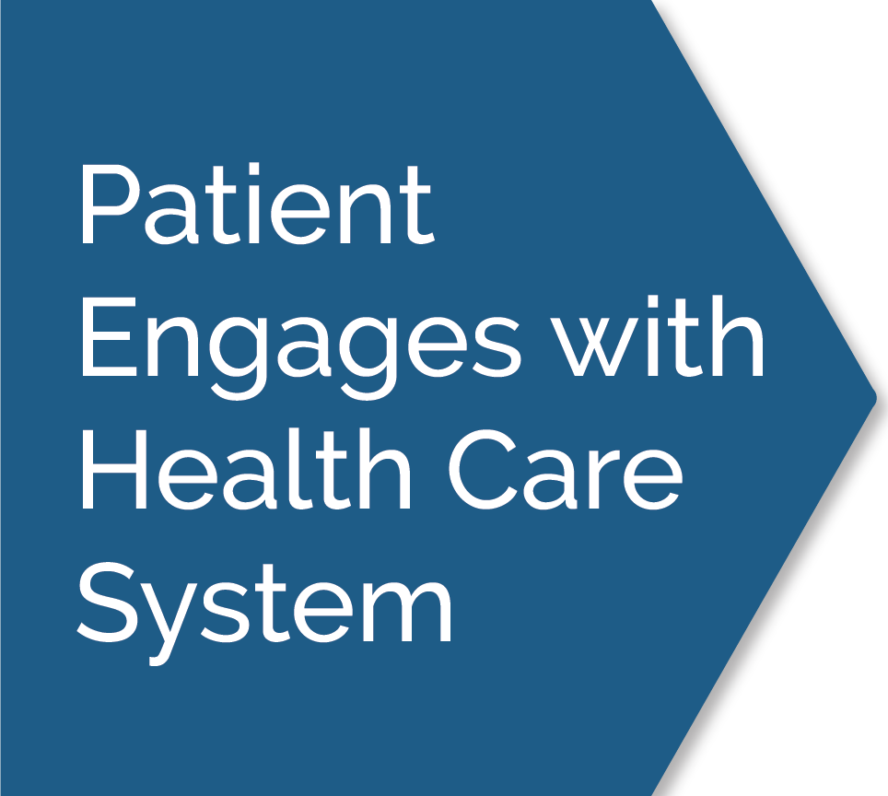
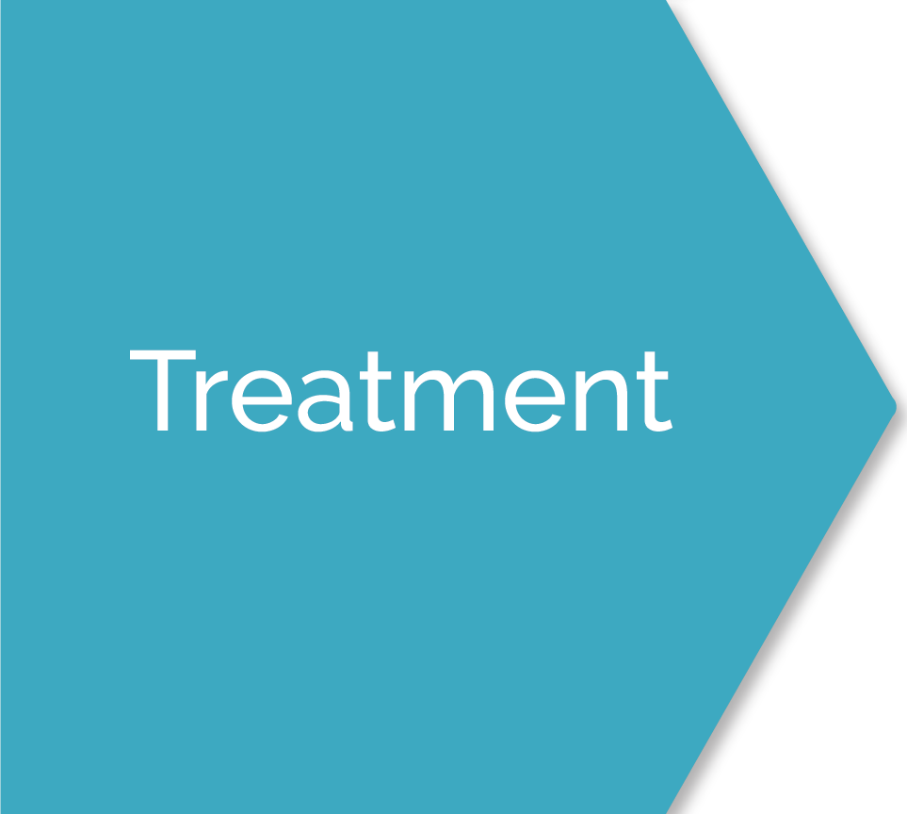
Diagnostic Process Map
Interactive Diagnostic Process Map, https://www.improvediagnosis.org/processes/the-diagnostic-process/, used and adapted with permission. National Academies of Sciences, Engineering, and Medicine. 2015. Improving Diagnosis in Health Care. Washington, DC: The National Academies Press. https://doi.org/10.17226/21794. Diagram can be found on p 3 of the report.
Notes:
o This image is called the Diagnostic Process Map, created by the National Academies of Medicine. This map explains in detail each step of the process of getting a diagnosis. The Society to Improve Diagnosis in Medicine, and the Academies developed an interactive version of the map and that’s what we’re going to walk through next.
o You will need to open up the interactive diagnostic process map from the SIDM website, or use the deck which provides a step-by-step version of the map with your discussions prompts for each.

Slide 4
Patient experiences a health problem
Consults with others
(family, friends, online, etc.)
Resolve situation
on their own
Patient explains their problems
in their own words
Notes:
o As you can see there are many parts of the diagnostic process, but we will review each piece one at a time. Please note that each step is color coded to align with the map.
o At the beginning of the map, we see that a patient experiences a health problem. The patient may resolve the situation on their own, or consult with others to find an explanation of the issue.

Slide 5
The decision to engage with healthcare systems is multifaceted.
Factors influencing this decision: Access, Cost, Trust.
Seeking healthcare initiates the formal diagnostic process.
Diagnosis varies based on the issue and healthcare provider.
Notes:
o Next, the patient, if they choose to do something about their issue, will have their first interaction with the health care system. There are many factors that go into the decision about whether or not to seek care. Concerns about cost or access to care can be barrier—for example, not having a “regular” doctor or worry about not being able to pay for care. Trust is also a major issue—patients that have had negative experiences with healthcare previously may be nervous to seek care. Choosing to seek care begins the “formal” diagnostic process.
o Let’s pause here and see if anyone has questions or comments on what we’ve just reviewed.
o This can be a short pause, just to be sure no one is confused.

Slide 6
Information required for a diagnosis
(in regular cases)
Patient shares their
clinical history
Physician conducts
physical examinations
In other cases, diagnostic tests or imaging studies may be required to gather essential information for an accurate diagnosis.
Notes:
o Now that the patient is in the health care system, the next three pieces function together to start identifying a diagnosis.
o There are two main steps here—the patient reporting their own medical history and sharing what’s going on, and the clinician performing an exam on the patient. There may be other tests needed at this time such as x-rays or blood tests, depending on what the issue is.

Slide 7
Healthcare providers, drawing on their medical knowledge, interpret gathered information to identify patterns that suggest specific diseases or disease types.
With approximately 200 known symptoms but over 10,000 possible diseases, there may be numerous potential diagnoses.
Clinicians should involve patients in the diagnostic process, discussing how their symptoms may fit with different diagnoses, and seeking patient input.
Notes:
o This step in the diagram explains how the clinician (or group of clinicians) start to pull the information together. They do this by drawing on their medical knowledge and interpreting gathered information to identify patterns that suggest specific diseases or disease types.
o With approximately 200 known symptoms but over 10,000 possible diseases, there are often many possible diagnoses!
o Clinicians should involve patients in the diagnostic process, discussing how their symptoms do or do not match different possible diagnoses, and asking the patient for their perspectives and input.

Slide 8
Clinicians create a prioritized list of potential diagnoses (differential diagnoses) when evaluating a patient's condition.
The most likely choice from the list is often designated as the working diagnosis, indicating a strong possibility but not yet confirmed, with other possibilities not ruled out.
Clinicians consider multiple diagnostic hypotheses and continuously refine the list as they gather more information, ultimately arriving at a "working diagnosis" during the diagnostic process.
Notes:
o With as much gathered information as possible, the clinician now starts identifying the options--creating a prioritized list of potential diagnoses (called differential diagnoses).
o The most likely choice from the list is often designated as the working diagnosis, indicating it is a strong possibility but is not yet confirmed, and indicating that other possibilities are not yet ruled out. The working diagnosis should be shared with the patient so they aware of what is suspected.
o As more information is gathered, the clinician continues to work through the list
o Let’s pause here for a moment—does anyone have any questions or is this making sense so far?
o Allow for a few minutes of discussion and clarification if needed then move on.

Slide 9
Information can be collected for the diagnosis using these methods:
Clinical History & Patient Interview
Physical Exam
Referral & Consultation
Diagnostic Testing
Notes:
o On the next few slides we will do a deeper dive into each of these elements of the appointment or assessment: Clinical History & Patient Interview, Physical Exam, Referral & Consultation, and Diagnostic Testing.

Slide 10
Appointment begins
Patient’s medical history
is compiled
Patient’s medical history
is verified
A patient's clinical history encompasses their current concern, past medical and family history, social background, and medication/supplement details.
Gathering a clinical history and patient interview demands effective, tailored communication with active listening.
Notes:
o We briefly touched on the patient’s history earlier, but now we can see in more detail the important information that comes about from this conversation. A patient's clinical history includes their current concern—the “thing” that has prompted them to seek care, past medical and family history, any aspects of their work or social life that might be relevant, any current medications or clinical regimens, and anything else that could be helpful—such as recent travel.
o Collecting a full and accurate history requires active listening and skilled interview techniques on the part of the clinician, and as much openness and accurate reporting as possible on the part of the patient.

Slide 11
Clinicians begin the physical exam by observing the patient's demeanor, posture, complexion, and distress levels, comparing them to prior interactions if applicable.
The examination encompasses a thorough assessment of various parts of the body beyond the current issue.
This holistic approach not only aids in refining the diagnosis but also minimizes unnecessary testing and fosters trust between the clinician and patient.
Notes:
o The physical exam is another important information gathering activity—and as you see here, often includes examination of the whole body rather than only the part or parts that appear to be affected by the person’s current concern.

Slide 12
Diagnostic testing refines the working diagnosis through successive rounds of information gathering.
It can confirm suspected diagnoses based on history and physical exams, such as using an electrocardiogram (EKG) to assess if a heart attack has occurred.
Diagnostic tests can include testing blood, urine, tissue, or other biologic material, medical imaging like x-rays or CT scans, and other tools.
Notes:
o The next component to consider is diagnostic testing—which allows for information beyond what the naked eye can see. This can involve testing the blood, urine, or other body fluids, taking tissue or other samples to analyze for infection or presence of disease, taking images of the affected body part, or even performing exploratory surgery or other procedures if needed.

Slide 13
Clinicians consult with peers for additional expertise, aiding in confirming or rejecting working diagnoses and exploring treatment options.
When a health problem exceeds a clinician's expertise, they refer the patient to a specialist.
Second opinions from another clinician can be recommended by the treating clinician or sought independently by patients when diagnosis uncertainty arises or for reassurance.
Notes:
o Finally, the important step of referral or consultation, if needed. Clinicians may consult with their peers, asking them to weigh in on the case and aide in confirming or rejecting the working diagnoses. When a health problem exceeds a clinician's expertise, they should refer the patient to a specialist. Sometimes patients themselves feel a second opinion from another clinician is needed, either because they are not entirely satisfied with the first explanation, or just because getting a second opinion can be a good idea for complicated issues.
o Let’s pause here and reflect on what we’ve just learned. Have you ever thought of diagnosis as a process before? Have you all experienced each of these steps? If not, which pieces were missing? Is the term “working diagnosis” familiar to you?
o Allow the group a few minutes of discussion before moving on.

Slide 14
Communicating the patient's health problem is a crucial part of the diagnostic process.
It can involve a single diagnosis, a category within a broader health issue (e.g., "upper respiratory tract infection"), or several possible diagnoses that may narrow down over time.
The explanation should be in understandable terms, alongside medical terminology.
Clinicians should confirm the patient’s understandability of the diagnosis, address questions, and ensure they understand the necessary next steps.
Notes:
o A critical element of timely and accurate diagnosis is communication. The patient's health problem should be explained fully in understandable terms, but also in combination with the appropriate medical terminology so the patient knows exactly what the issue is—for example, telling the patient they are experiencing a sudden heart attack (which is in lay language), but also explaining that in medical terms this is called an acute myocardial infarction. Clinicians should confirm the patient’s understanding of the diagnosis, address questions, and ensure they understand the necessary next steps.
o This may be a new way of thinking about diagnosis—but communication is considered an important part of diagnosis. What have your experiences been with having a diagnosis communicated—or not?
o Allow discussion for a few minutes before moving on to the next slide.

Slide 15
Treatment is the planned path of care following the diagnosis.
Sometimes this may be a treatment trial if the diagnosis is not certain.
Other times it may be appropriate to defer specific treatment until the diagnosis is more certain.
Notes:
O Once the diagnosis has been communicated, it may be time to begin treatment. Sometimes a treatment is started as a test—to see if it will work. In those cases, the treatment is used as another tool to find the right diagnosis; if the treatment does not work for the suspected diagnosis, it may mean it was the wrong diagnosis. Other times the treatment plan is more firm because the diagnosis is more definite. And still other times it may not be possible to start treatment because the diagnosis is still too unclear.

Slide 16
The results of the diagnostic procedure hold significant importance.
Questions like, "Was the health problem identified?" and "Did symptoms resolve?" are essential.
Assessing the impact of illness, including physical, emotional, and financial aspects, is vital.
Outcomes also aid healthcare providers, practices, and organizations in continuous improvement.
Notes:
o And perhaps most importantly are the outcomes from the diagnostic process. Did the issue resolve? Is the patient doing well? Was the diagnosis caught quickly enough to avoid unnecessary harm?
o Here again, treatment and outcomes may not be things we have linked with diagnosis before, but as you can see, they are an important part of this cycle. If the treatment doesn’t work after a certain amount of time, it may be necessary to back up a few steps and restart the process as you can see in the graphic.
o Has anyone had experience with revisiting a diagnosis before? Needing to go through the cycle more than one time in order to land on the right diagnosis?
o Allow for a show of hands or nods, and if someone offers an example, allow 2-3 minutes to discuss, otherwise, move on to the next slide.

Slide 17
What Can Help Make Diagnosis Accurate, Timely, and Well-communicated?
Effective Teamwork
Reliable Diagnostic Process
Engaged Patients & Family Members
Optimized Cognitive Performance
Robust Learning Systems
1
2
3
4
5
KEY DRIVERS
Notes:
o Now that we have discussed and learned the diagnostic process map, we are going to look at some of the main factors that influence diagnosis.
o What we see here is a version of what is called the “Key Drivers Diagram”, which was created by a team of people studying diagnosis. They identified a few key “drivers” that can help make diagnosis happen more quickly and correctly.
o First is teamwork. Diagnosis is a “team sport” because each person on the team brings a different perspective. For example, a nurse might be seeing a decline in a patient that the physician isn’t seeing because she hasn’t spent as much time in the room. It is important that every team member is heard and has an opportunity to weigh in on what’s happening.
o As you think about your own care, have you ever had experiences in which different members of the care team responded differently or maybe you had a connection with one team member and not others?
o Pause and allow 2-3 minutes for input or discussion.

Slide 18
What Can Help Make Diagnosis Accurate, Timely, and Well-communicated?
Effective Teamwork
Reliable Diagnostic Process
Engaged Patients & Family Members
Optimized Cognitive Performance
Robust Learning Systems
1
2
3
4
5
KEY DRIVERS
Notes:
o Next is the presence of reliable diagnostic processes; this is really about the “technical” parts of making a diagnosis—like making sure blood tests are done correctly or making sure the right information is entered about the right patient in an electronic medical record. So you can imagine why that is an important piece. Does anyone have any questions or comments about this piece of diagnosis?
o Pause and allow 2-3 minutes for questions or discussion.

Slide 19
What Can Help Make Diagnosis Accurate, Timely, and Well-communicated?
Effective Teamwork
Reliable Diagnostic Process
Engaged Patients & Family Members
Optimized Cognitive Performance
Robust Learning Systems
1
2
3
4
5
KEY DRIVERS
Notes:
o Now we come to the engagement of patient and family members in the diagnostic process—and this one speaks for itself! As we all know, it is so important that patients and families are engaged in their own care and their diagnostic processes—so this “driver” is about making sure patients and families are looked to as partners—that they are given the right information, that they can contribute their own thoughts and ideas, etc. What are your experiences with being included—or not being included—in your own care? Or in the process of getting something diagnosed?
o Pause and allow 2-3 minutes for discussion.

Slide 20
What Can Help Make Diagnosis Accurate, Timely, and Well-communicated?
Effective Teamwork
Reliable Diagnostic Process
Engaged Patients & Family Members
Optimized Cognitive Performance
Robust Learning Systems
1
2
3
4
5
KEY DRIVERS
Notes:
o Next is optimized cognitive performance, which is basically a fancy way to say “how clinicians think”—how they pull together all the pieces of information from us as patients, from tests, from our history, and try to make a determination of what the likely issue is. You’ll remember from the diagnostic process map, this is the circle in the middle—gathering information, integrating and interpreting that information, and then determining a “working diagnosis”. Sometimes it takes time to know if the diagnosis was right—if treatment is used, and it doesn’t seem to work, there might be something we need to go back to at the beginning of that cycle—was something missed? Could it be something else? And try a second time.
o These thought processes can be helped through training, and practice, and increasingly, technology. Does anyone have any questions or comments to share on this topic?
o Pause and allow for 2-3 minutes for discussion.

Slide 21
What Can Help Make Diagnosis Accurate, Timely, and Well-communicated?
Effective Teamwork
Reliable Diagnostic Process
Engaged Patients & Family Members
Optimized Cognitive Performance
Robust Learning Systems
1
2
3
4
5
KEY DRIVERS
Notes:
o And finally, there is a need for robust learning systems—so, opportunities to stop and study and learn—what’s going well at this hospital? What’s not? When there is a mistake—a diagnostic error—do we learn from it, and put processes or systems in place to make sure it doesn’t happen again? This can include things like reporting systems, or evaluations to see how well the hospital is doing.
o In thinking about your own care, or about our hospital, are you aware of any systems like this in place that try to study what’s going on and understand if the diagnostic process is working as well as it can?
o Pause and allow for 2-3 minutes of discussion.

Slide 22
Let’s review what we’ve discussed
The diagnostic process and interactive process map
Your experiences with the diagnostic process
“Key Drivers” for diagnostic quality
Notes:
o We have discussed a lot today, so let’s take a minute to review everything we’ve covered and shared.
o We began with reviewing and exploring the National Academies/SIDM interactive diagnostic process map which walked through each step of the diagnostic process, including the cyclical nature of the process—that sometimes it is necessary to go around the loop more than once to identify what the issue really is.
o Here, integrate any comments or questions from the group that would be valuable to repeat such as examples folks shared during the diagnostic process map exercise.
o We then reviewed some of the best practices in the field of diagnosis—these were called the “key drivers” that can support accurate and timely diagnosis. Effective teamwork—so, all members of the team have a say and work together, reliable diagnostic processes—the technical pieces like blood tests and electronic medical records, patient and family engagement— patients and families are PART of that diagnostic team, optimal cognitive performance—meaning, clinicians are best able to process and integrate information to make a diagnosis, and finally, robust learning systems—which means there are things in place to make sure we learn from what goes well and doesn’t go well.
o Is there anything else anyone wants to ask or say before we close?
o Pause and allow for 2-3 minutes of discussion.

Slide 23
Thank You!
Notes:
o Thank you so much for your time and participation—this was a great and productive discussion!
o The next section in the toolkit is about when things break down in the diagnostic process—what we call diagnostic error.

