Slide 1
Section 4. Diagnosis and You Part One: Learning from Diagnostic Experiences
Notes:
o This is Part One of Section 4, Learning from Diagnostic Experiences. In this section, we are going to zoom in a bit to the individual level and think more about how we all have experienced diagnosis and the diagnostic process.

Slide 2
Diagnosis at the Individual Level
Notes:
o So far in this toolkit, we’ve talked about patient and family engagement—Type A, engagement of patients and families in their own diagnosis and care and Type B, engagement of patients and families as partners and advisors in system or organizational level efforts—like PFACs.
o We’ve learned about the diagnostic process, diagnostic errors, and some of the practices that patients, clinicians, and hospitals can use to try to maintain diagnostic quality.
o In this section, we’ll start tying it all together and bringing it back to us, as individuals and as patients and consumers of healthcare.

Slide 3
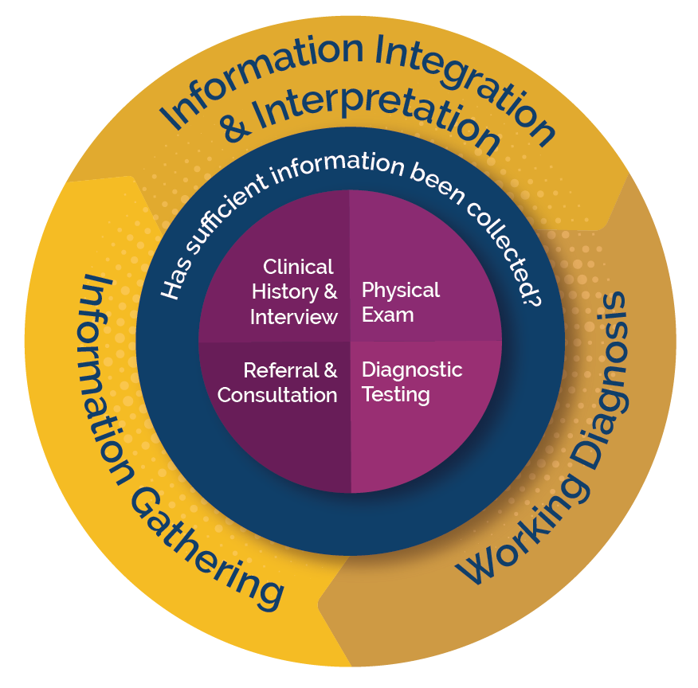
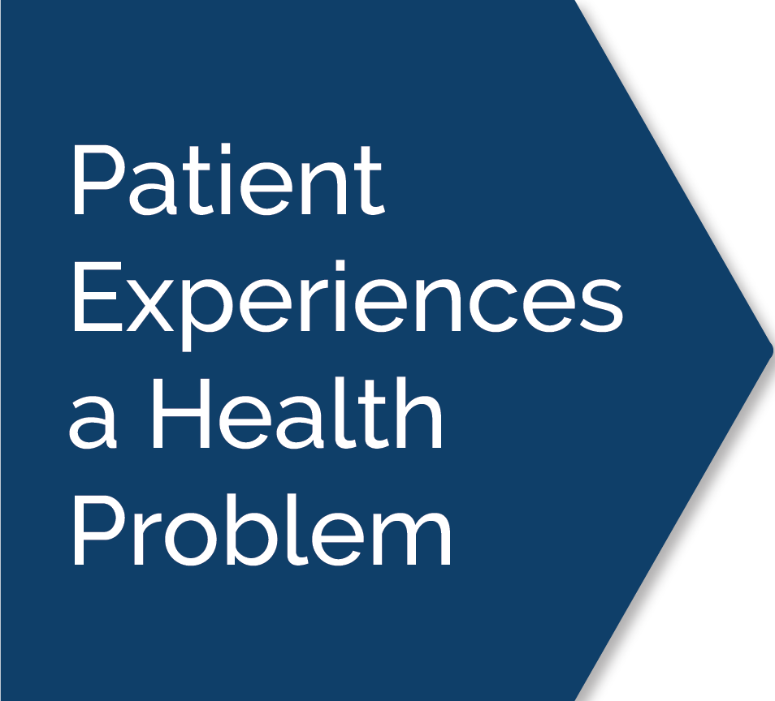
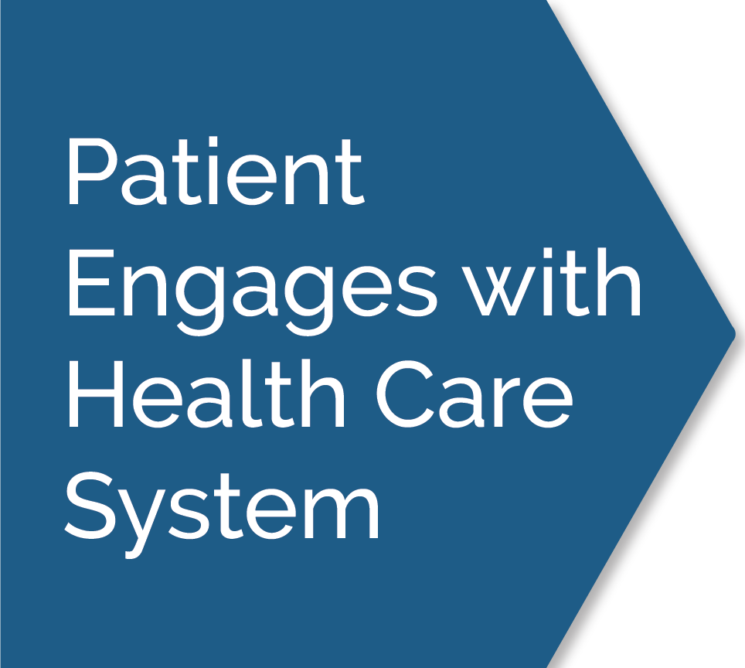
Reminder: Using Diagnostic Experiences as Learning Opportunities
Notes:
o You’ll remember from previous sections, we reviewed the National Academies diagnostic process map and talked about each of the steps in the diagnostic process.
o We’ve also done some brainstorming and had discussions about some of your experiences with healthcare, including your experiences going through the diagnostic process.

Slide 4
A Tool for Exploring Diagnostic Experiences
Click here to play the video
Notes:
o For this section we’re going to spend some time using an important tool called the What if? template. The tool was designed to help patients, families, PFACs, hospitals, clinicians, and others learn from and share their diagnostic experiences—both good and bad.
o Some of you may have joined this PFAC because of a diagnostic experience you or a loved one had. That experience will be helpful when learning about and using this tool. For others of you, using the tool might require a little bit of creativity or practice, but it will almost certainly be valuable. Before we dive into the tool we’re going to watch a short video that describes how the tool is meant to work, and how different patients or family members have used the tool to describe their diagnosis stories, and identify opportunities for learning about and improving the diagnostic process.
o The video is hyperlinked at the bottom of slide 4. Click on the hyperlink and make sure the volume is turned up and the video plays correctly. Facilitation is not required during the video—it has both audio and visual effects and is meant to function on its own. When the video concludes, exit out of that screen and return to the Part 1 of Section 4,and advance to slide 5.

Slide 5
Now: How can we learn from diagnostic experiences?
Notes:
o Any questions or comments about the instructional video? Now that the idea and the purpose for the What if? template have been explained, we are going to try it out ourselves
o Pass out hard copy versions of the template for people to use for the exercise; if your meeting is virtual, remind everyone that the template was emailed to them in advance and that they should use their printed off hard copies or use scratch paper to jot down their thoughts and the responses to the template questions.

Slide 6
Exercise: Using the What if? Template
Notes:
o Before getting started let’s briefly think about what story or experience we’ll each use as we fill out the template—focusing on the process of getting a diagnosis. This could be your experience, or someone you know. It could be a good experience or a bad one, it could be something that happened in a hospital, or something that happened outside the hospital in a clinic or physician office. It could be something that happened in just a few days, or something that happened over several month. Everyone is different and our experiences are too. You may not have all of the details about what happened, but that’s okay. I’ll pause and let you all think for a minute—and feel free to ask questions or share your ideas if you need any help or suggestions.
o Keep in mind that we won’t use last names or any identifying information about the patient, the clinicians or hospital involved, or anything else that must or should be kept private. If you’d prefer not to use the first name of your loved one, you can make up a name to use.
o Give everyone 60-90 seconds time (adjust as needed) to think about what story or experience they may want to share, be on the lookout for raised hands for folks who need or want clarification about what they should be doing.
o Okay. Does everyone have a story in mind?
o Scan the room to make sure most folks have a story in mind (nodding heads). If someone needs extra time or assistance, give them more time.
o As we work through each section of the template, I will share pieces of an example that comes from one of the creators of this toolkit, about a problem getting an infection diagnosed after a surgical procedure. Please keep in mind, this is just an example to help explain how to use the template. There is no correct or perfect answer to these questions; everyone’s responses will be correct and valuable!

Slide 7
Exercise: Using the What If? Template
Introduction
Age, gender, other demographic characteristics of patient
Background
How long had symptoms been going on and what were they?
What had been going on up to the point that this diagnostic error occurred? What were the healthcare interactions up to now?
Notes:
o The template starts with some general information and background. The very first question just helps set the stage for who the patient is—whether it is you or your loved one. These should just be very simple answers such as those we saw in the video. They can be details like age, gender, race, or ethnicity, and anything else that seems important to share such as occupation, location, or other key characteristics.
o The next question is meant to provide some basic information leading up to the experience…what’s the background? Had anything been going on or was this problem or symptom brand new? As we saw in the video, everyone’s experiences are different from one another, and that means some elements of the template will be a perfect fit and others won’t. In some cases you may have to just do your best to interpret what the template is asking of you. Let’s take a few minutes to add a few notes to this section.
O Give 4-5 minutes to allow people to draft their responses in their own templates. After some time has passed, ask if folks are done. If they need more time adjust accordingly. Move to next slide when ready.

Slide 8
Example: Nancy’s Infection
Introduction
Nancy, age 35
Nurse
Lives in a rural area far from hospital
Background
Carpal tunnel surgery
Unusual and severe pain reported to surgeon
Seen by surgeon, no visible signs of infection in wound
Pain diagnosed as normal post-surgery pain
Pain became so bad, she went to the Emergency Department
Notes:
o So for the example provided in the toolkit, we see that it was a woman named Nancy, she was 35 and was a nurse. She lived in a rural area and was pretty far away from the nearest hospital.
o For the background, Nancy had carpal tunnel surgery on her left wrist. The surgery was done outpatient on a Monday, but by Wednesday she was having some unusual and severe pain and had reported it to the surgeon. She had an appointment with him on Thursday, and he said the wound looked fine, so she believed the pain was just normal post-surgery pain. By Saturday morning she was in such pain she decided to go to the Emergency Department at the hospital about an hour away.
o Is the exercise making sense so far? Does anyone have questions, or do you feel ready to move on to the next step?
o Respond to questions or provide additional explanation as needed and when the group seems ready, move to the next slide. Some group members may see the example and want to make some slight changes to their template responses, which is totally fine. If they ask to see the prior slide to be reminded what the questions were, you can skip back to that slide until they’re ready to move on and then move on to slide 9.

Slide 9
Exercise: Using the What If? Template
Presentation
Presentation
What happened when you arrived at the point of care?
What clinical information do you have from that time?
Vital signs?
Major symptoms?
History that you reported?
Anything else you can recall?
Hospital Course (if inpatient) or Course of Care/Treatment (if outpatient)
Tests or exams given?
Any provisional diagnoses suggested to you?
Any courses of treatment offered to you?
Notes:
o Our next question gets right into the main points of your story by focusing on the “thing” that ultimately brought the patient to the hospital or clinic. This moment or event is often called the “presentation”—when the patient “presented” with symptoms to whatever the care setting was.
o We have another question about the “course of care”. This question is a good example of how different people will have very different responses to the template questions because our experiences are so different from one another. Some people’s stories all happened in one hospitalization; other’s happened over the course of many days or weeks with many visits to different hospitals. There are no wrong answers, this is all just a way to capture the main points about what happened and identify the learning opportunities from them.
o Give 4-5 minutes to allow people to draft their responses

Slide 10
Example: Nancy’s Infection
Presentation
Presentation
Nancy arrived at the ED complaining of unusual and severe pain in the wrist where the surgery had occurred.
The team immediately examined the wound, took a sample of the pus coming out of the wound, and began running other tests
Hospital Course (if inpatient) or Course of Care/Treatment (if outpatient)
Initially broad-spectrum antibiotic and fluids, then more targeted treatment once the infection was identified
Hospitalized for several weeks, required physical therapy after discharge
Notes:
o In the example provided in the toolkit, Nancy arrived to the Emergency Department and explained that she was in extreme pain in the wrist where the surgery had happened. The team taking care of Nancy took a sample of some of the pus on the wound to run tests on it. They also took her temperature and ran several blood tests to see if there were any signs of infection or inflammation in her blood.
o In terms of the course of care—which in her case was in the hospital--they shared with her that the wound was clearly infected, and that they were running tests to understand how serious the infection was and to identify the type of infection. They started her on a “broad-spectrum” antibiotic and IV fluids while they waited for test results to come back. She ultimately required several weeks in the hospital to receive treatment, fluids, and to monitor for signs of sepsis (the body’s significant and sometimes life-threatening reaction to infection). After she was discharged from the hospital, she required several weeks of physical therapy to regain function in her wrist and hand—beyond what the regular carpal tunnel surgery would have required.
o Any questions or clarifications here, or are we ready to move forward?
o Respond to questions or provide additional explanation as needed and when the group seems ready, move to the next slide. Some group members may see the example and want to make some slight changes to their template responses, which is totally fine. If they ask to see the prior slide to be reminded what the questions were, you can skip back to that slide until they’re ready to move on and then move on to slide 11.

Slide 11
Exercise: Using the What If? Template
Ultimate (Correct) Diagnosis
What was it?
Who found it/identified it?
What damage, harm, or tragic outcome resulted?
Discussion
Provide a few clinical details about the ultimate diagnosis, perhaps including statistics or other insight
Include any details you or family members noted as unusual or worrisome during the course of care/treatment
Notes:
o This next question is the crux of the story—what was the ultimate diagnosis and how did it come about? At this point in the template, it may feel like the questions are more oriented to a bad or negative diagnostic experience—which is understandable because this was developed in a project about diagnostic errors. However, you can complete these segments even if the story you’re describing is a positive one and I can help you if you run into any challenges.
o And finally, we start to get into the discussion portion which is where we can really tease out some of the learnings or opportunities. Here again, please don’t provide last names of people or names of specific hospitals or clinics, or other information that would be too private, but general concepts and memories from the experience can be helpful to list out.

Slide 12
Example: Nancy’s Infection
Ultimate (Correct) Diagnosis
MRSA infection after surgery
Spread to the bone in her wrist/arm
Discussion
Several weeks in hospital for antibiotics, fluids, and other treatment
Delay in diagnosis of the infection allowed it to spread to bone and put her at risk of developing sepsis
She required additional physical therapy and other rehab to regain full use of wrist and hand
Notes:
o In the example provided in the toolkit, Nancy ultimately got the diagnosis of a MRSA (Methicillin-resistant Staphylococcus aureus) infection in the wound from her carpal tunnel surgery.
o By the time she came to the Emergency Department, the infection had spread into her bone. Nancy had communicated the “unusual” and severe pain she was experiencing to her surgeon, but he did not see objective signs of infection when he examined the wound, so he diagnosed it as normal post-surgery pain. That allowed the infection to continue to worsen and spread until she decided to seek care in the Emergency Department later that week.
o Any questions or comments or are we ready to move on to the final step?
o Respond to questions or provide additional explanation as needed and when the group seems ready, move to the next slide. Some group members may see the example and want to make some slight changes to their template responses, which is totally fine. If they ask to see the prior slide to be reminded what the questions were, you can skip back to that slide until they’re ready to move on and then move on to slide 13.

Slide 13
Exercise: Using the What If? Template
Teaching points/
Opportunities to Improve
What were the breakdowns that, had they not happened, or happened differently, the error or resulting harm could have been avoided—the “What Ifs”?
What can be learned from your case?
What do you want practicing clinicians/hospitals/other stakeholders to take away from what happened to you?
Notes:
o Now we are at our final question, which is probably the most important one—figuring out what could have been different—the “What if? question, and what can be learned. If it was a negative experience, what would have prevented it? Or what could improve such a thing in the future? If it was a positive experience, what could be repeated or expanded so that more patients could benefit from it? It is okay if you don’t have fully formed ideas here for how to improve the “thing” that went wrong…even just framing it as a question is enough for now. I’ll give you all a few minutes to identify these “What ifs” and any ideas for making improvements—or building on positive things that happened.
o Give 3-4 minutes to allow people to draft their responses.

Slide 14
Example: Nancy’s Infection
Teaching points/
Opportunities to Improve
What if the reports of unusual and severe pain raised the clinician’s level of suspicion for infection even without visible signs?
We need better tools and training for clinicians to use in assessing symptoms like pain that are difficult to measure
Notes:
o In the example provided in the toolkit, Nancy wanted to know, What If? the surgeon had believed my reports of unusual and severe pain and suspected an infection even though there weren’t visible signs of an infection? She does not have a specific idea for how to make that happen—but her idea for what to take away and learn from this experience is that we need better training or better tools to help clinicians better assess patient reports of pain, and to catch infections even if there are not visible signs.
o Any questions or comments before we move forward?
o Respond to questions or provide additional explanation as needed and when the group seems ready, move to the next slide. Some group members may see the example and want to make some slight changes to their template responses, which is totally fine. If they ask to see the prior slide to be reminded what the questions were, you can skip back to that slide until they’re ready to move on and then move on to slide 15.

Slide 15
Sharing Back
Examples to share?
Please provide a brief summary of the experience, and then 1 or 2 important learnings/ideas for improvement in the diagnostic process and approaches
Notes:
o Now that we’ve walked through the template, let’s hear some of the What Ifs? or some of the ideas for learning or improvement that were generated during this exercise. You heard and saw the example of Nancy. What experiences did others of you write about?
o Ask for volunteers and allow 1 or 2 PFAC members to share, or more if time permits. If no one wants to share, you can move on to the next slide

Slide 16
Let’s review what we’ve discussed
We learned about the "What if" Template
We worked through some of our own diagnostic experiences to identify action items or ideas for projects
Notes:
o Let’s take a minute to review everything we’ve just covered and shared.
o In this section, we brought things back to the individual level and used one of the toolkit templates called the What If? template” to work through an example of a diagnostic experience, either negative or positive. This is just one example of how PFAC members can bring their lived experience to the work of the PFAC to suggest ideas for projects, or bring things to the attention of others.

Slide 17
Thank You!
Notes:
o Thank you so much for your time and participation—this was a great and productive discussion!
o In the next section, we’ll start to get practical and look at what types of diagnostic quality and safety work this PFAC may want to try to tackle at our hospital.

