Slide 1

Addressing Diagnostic Quality and Safety
Notes:
Welcome and thank everyone for attending the meeting.

Slide 2
Agenda for Today
Introductions
PFAC members’ experiences with diagnosis
Diagnostic safety information
Examples of other PFAC efforts in diagnostic quality and safety
Discussion
Notes:
Walk through the agenda.

Slide 3

Introductions
Notes:
Time time to allow everyone in the room to introduce themselves, their role, and why they are attending the meeting.

Slide 4



Diagnostic Error Statistics
One in 20 patients in outpatient settings will experience a diagnostic error = 12 million Americans annually
Patients experiencing medical errors report misdiagnosis more often (59%) than any other error
Across care settings ,roughly 795,000 , people are permanently disabled or die each year from diagnostic failures
Estimates of the costs associated with diagnostic error exceed $100 billion per year
Sources: “Improving Diagnosis in Healthcare” National Academy of Medicine 2015 report, Newman-Toker DE, Nassery N, Schaffer AC, et al. BMJ Qual Saf Epub ahead of print:doi:10.1136/
Bmjqs-2021-014130, Newman-Toker DE, Schaffer AC, Yu-Moe CW, Nassery N, Saber Tehrani AS, Clemens GD, Wang Z, Zhu Y, Fanai M, Siegal D. Serious misdiagnosis-related harms in malpractice claims: The "Big Three" - vascular events, infections, and cancers. Diagnosis (Berl). 2019 Aug 27;6(3):227-240. doi: 10.1515/dx-2019-0019. Erratum in: Diagnosis (Berl). 2020 May 16;8(1):127-128. PMID: 31535832
Notes:
The definition of diagnostic error used by the creators of this toolkit, is an event where one or both of the following occurred, with harm or high potential of harm to the patient:
Delayed, wrong, or missed diagnosis: At least one missed opportunity to pursue or identify an accurate and timely diagnosis based on the information that existed at that time and/or
Diagnosis is not communicated to the patient: Accurate diagnosis was available but was not effectively communicated to the patient or family.
This slide provides some of the most recent facts and figures on the diagnostic errors in the United States. As you can see, 1 in 20 patients will experience a diagnostic error in the outpatient setting each year, and among all of the types of medical errors, patients and families report diagnostic errors more than other types of errors.
Across all types of care—including care provided in the hospital—as many as 795,000 people are made permanently disabled or die due to diagnostic errors each year, and diagnostic errors are estimated to cost over $100 Billion annually.

Slide 5
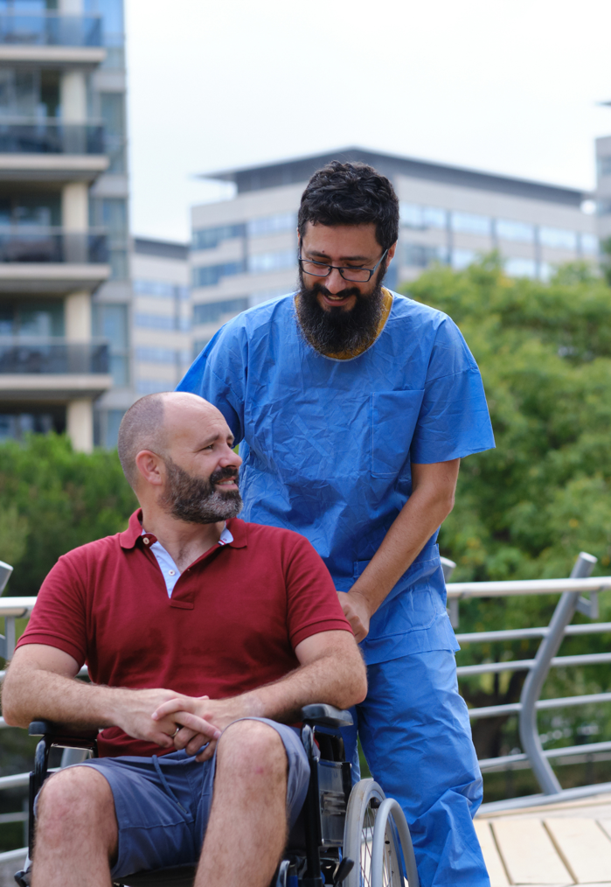
Our Experiences as Patients and Families
Notes:
Any PFAC members with diagnostic error experiences take a moment to share them; if there are not diagnostic error examples, any examples of breakdowns in care will also be valuable.
PFAC members should use the “What if” template to prepare for sharing their stories and in order to allow for enough time, keep their stories to 3-4 minutes, always ending in a proposed action item for the hospital.

Slide 6

Examples from Other PFACs
The PFAC at RWJ Barnabas Health created and provided a communication module to staff to help improve communication with patients and families. Communication breakdowns are a major contributor to diagnostic errors.
https://www.rwjbh.org/patients-visitors/patient-family-advisory-council/accomplishments/
Notes:
Paraphrase the wording on the slide to describe what the PFAC did.

Slide 7


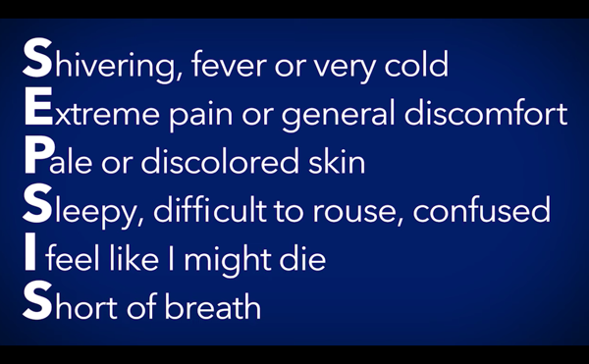
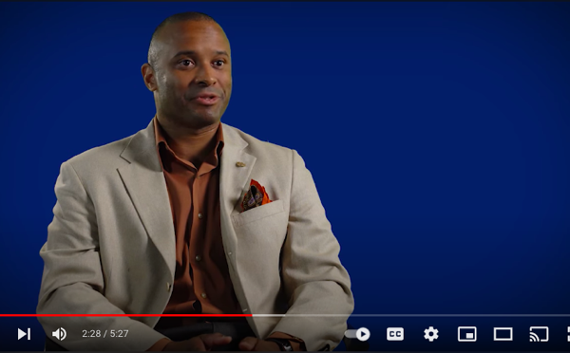
Examples from Other PFACs
https://www.medstarhealth.org/quality-and-patient-safety/sepsis-prevention-education
Notes:
At Medstar Health, the PFAC partnered in a “say the word sepsis” campaign to improve the speed and quality of diagnosing sepsis.

Slide 8
Discussion
How is diagnostic quality and safety handled in this institution (what processes or systems are in place?)
What type of information is available for us to see (such as HCAHPS data) to learn more about diagnostic quality here?
Are there any projects or topics you would suggest we (the PFAC) take on?
Notes:
Work through these discussion questions with the group

Slide 9
Next Steps
Notes:
As time draws to a close, narrow down on any specific next steps and action items for the people in the room.

Slide 10
Thank You!
Notes:
Thank everyone for their time and willingness to participate in today’s meeting.

